Slide 1
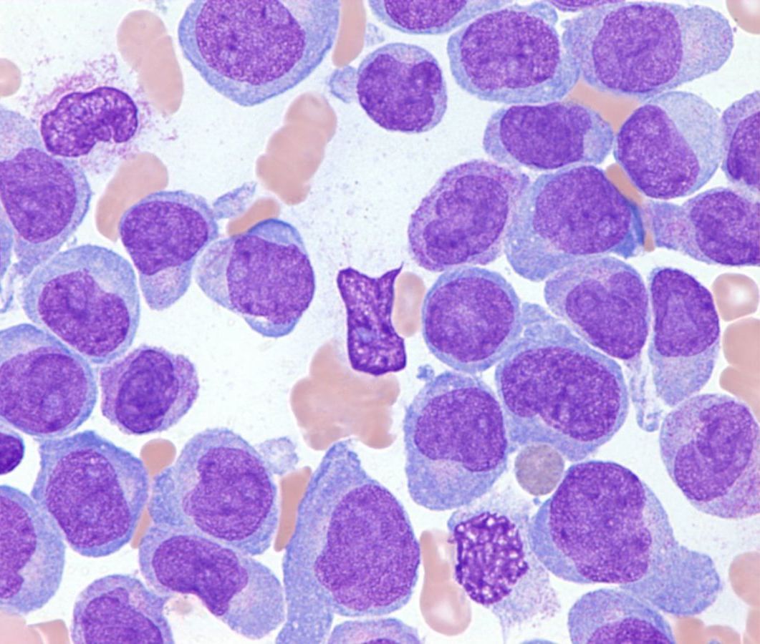
BST209 Group Presentation: Predicting leukemia mortality amongst patients in the ICU
Sumedha Arya, Naira Link, Joao Matos, Richard Newcomb, Pratiksha Pradhan, Yusuka Takeda

Slide 2
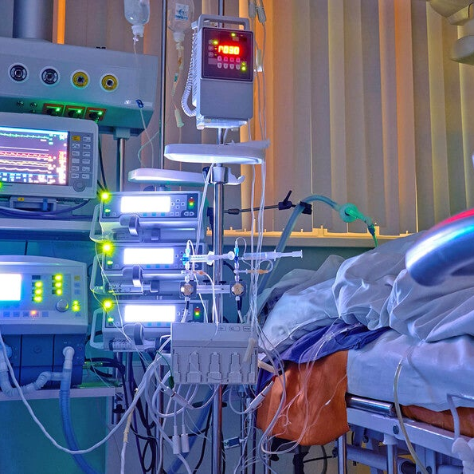
Clinical Question
Amongst patients with acute leukaemia within the ICU, can we predict who is most likely to die within 90 days?

Slide 3

Problem Definition: Potential for Improvement
The model would improve patient outcomes by:
(1) giving clinicians improved information regarding which factors may be most influential towards patient mortality, particularly for correctable factors (2) Assist with joint decisions between patients, caregivers, and clinicians regarding code status and early palliative care efforts (3) Help guide compassionate counselling to patients and families regarding potential life expectancy

Slide 4
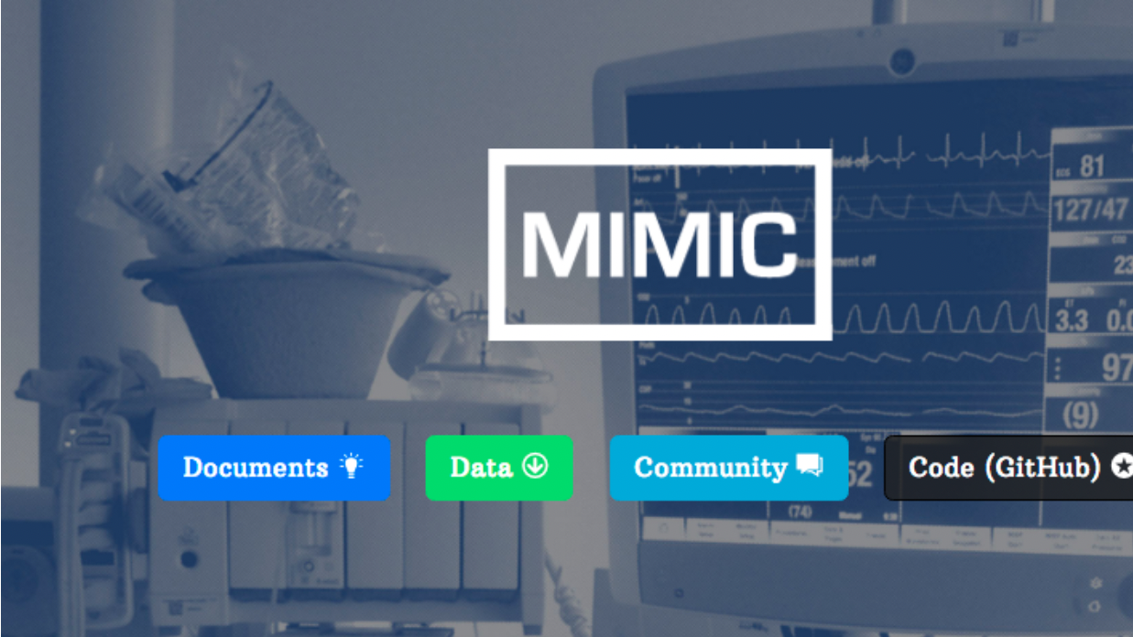
Database Use
MIMIC-IV: Patients admitted to the ICU unit of Beth Israel Deaconess Medical Center in Boston, Massachusetts between 2008-2019
ISSUES:
Selection bias: Patients who are selected may not be represented of entire population; selecting people with access to care and medical resources
Immortal time bias: error in estimating exposure and outcome associations due to misclassification or exclusion of time intervals
Diagnostic suspicion bias: certain patients may be missing data based on clinician’s diagnostic thresholds
Generalizability: may specifically represent the Massachusetts population demographics; may not be a diverse population

Slide 5
Inclusion, Exclusion & Issues
Inclusion: All patients with acute leukemia admitted to the ICU
Exclusion: 1.Re-admissions to the ICU from same hospitalization, or subsequent readmissions to ICU in further admissions 2. ICU LOS </= 24h
Issues:
Misclassification bias due to ICD-10 codes – clinician billings Same biases as noted previously; selection bias particularly: exclusion of subsets who may not be captured by MIMIC-IV

Slide 6
MIMIC clinical features
Age
Sex
BMI
Race
Charlson comorbidity index
Hb, WBC & neutrophils, platelets, fibrinogen (worst i.e. nadir on admission date to ICU)
Lactate (worst i.e. highest on admission date to ICU)
Sepsis
Source of infection (i.e. billed within top 3 dx for a given patient)
Pre-ICU length of stay (number of days)
Pressor requirement
Mechanical ventilation
Renal replacement therapy

Slide 7




Novel features: NLP
Performance Status
Leukemia Risk
Leukemia History
Clinical notes
Pathology reports
ICU Indication

Slide 8
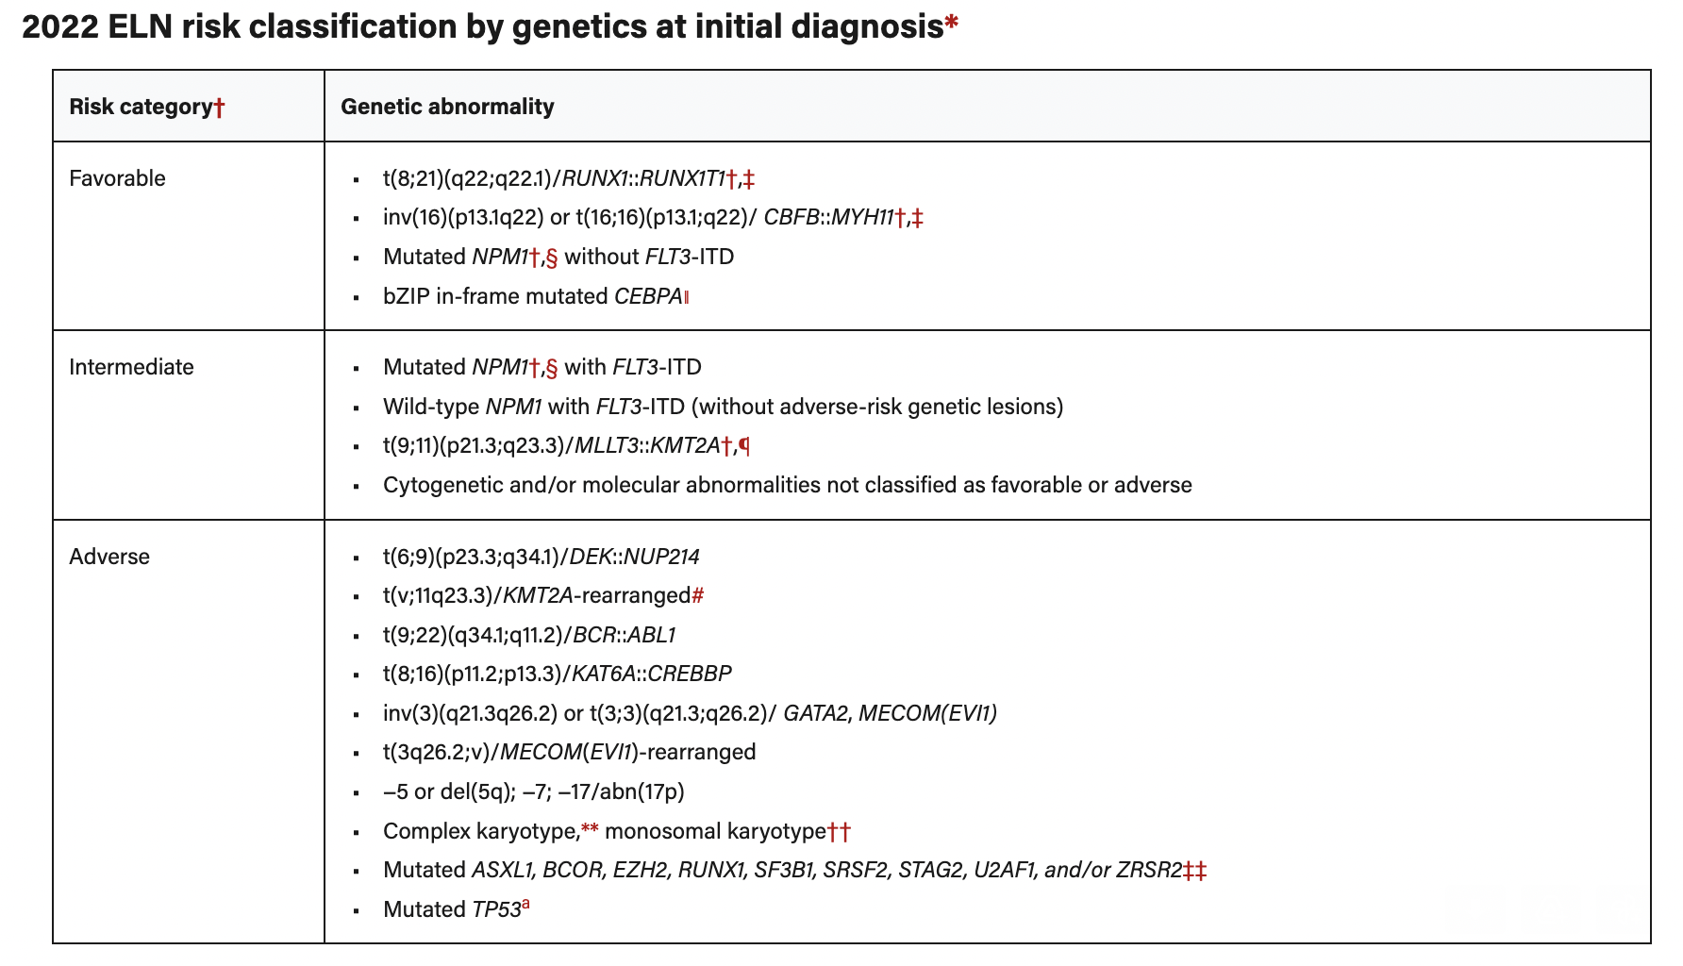

Slide 9
Limitations of selected features
Missing data – i.e., lactate, hemoglobin
Certain populations may be less likely to have pertinent laboratory values especially racial/ethnic minority groups
Accuracy of NLP model:
Unable to capture granular leukemia data
Bias is present in clinical documenation

Slide 10
Outcome
90-day mortality
Why? Felt to be a clinically meaningful time point for patients, and helpful in terms of advanced decision planning
Often, may influence decision regarding hospice or home care
Strengths & challenges:
Hard outcome – mortality (especially all-cause) unlikely to be misclassified
Unlikely able to accurately capture disease-specific mortality
Often mis-coded
90-day felt to be clinically important; however, may vary across time-points

Slide 11

Analyses
Assess importance of NLP generated features to model performance
Compare NLP+ model performance to “general” ICU prediction models:
OASIS
SOFA
Our model will be ‘overfitted’ to our specific patient population: strength and weakness
Would a similar approach work in other groups of patients with cancer?

Slide 12

Questions?

